Slide 1

Data Preprocessing in ML

Slide 2


What is data pre-processing?
Data pre-processing is a step in Machine Learning where we transform data before feeding it to the model.
This helps machine to easily parse it and thus improves the ability of our model to learn and its efficiency.
There are huge amounts of data in different formats which is not understood by the machine, thus pre-processing it is very helpful.

Slide 3


Process of data pre-processing
For structured data, data pre-processing operations include the following:
Data cleansing – The raw data has missing, corrupted and invalid data so its important to remove these. This is called Data cleansing.
Instances selection and partitioning- This includes techniques for repeatable random sampling, minority classes oversampling, and stratified partitioning. Selecting data points from the input dataset is important to create training and test sets.
Feature tuning- This includes scaling and normalizing numeric values, imputing missing values, clipping outliers, and adjusting values with skewed distributions.

Slide 4
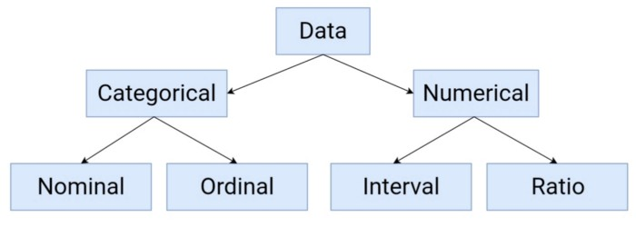
Representation transformation. - It is important to test efficiency of the model by checking whether it supports numeric or categorical features or both. Thus a system is benefited by this type of pre-processing.
Feature extraction. Reducing the number of features improves the models working. We can achieve this by creating lower-dimension, more powerful data representations using techniques such as embedding, extraction, and hashing.
Feature selection - Selecting a subset of the input features for training the model, and ignoring the irrelevant or redundant ones, using filter and wrapper methods improves the model.
Feature construction.-Creating new features either by using typical techniques will help the model. Features can also be constructed by using business logic from the domain of the ML use case.

Slide 5
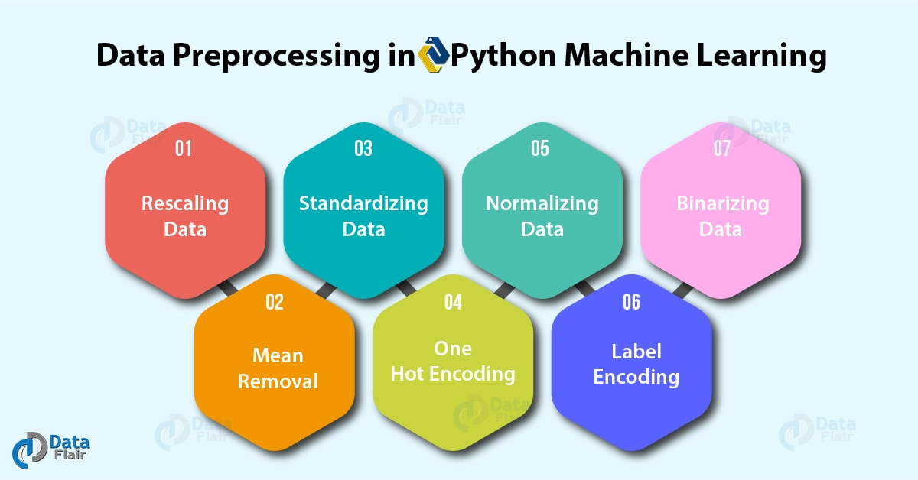

Slide 6
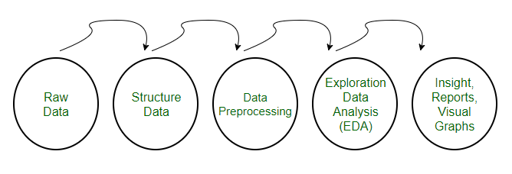
What comes before and after data pre-processing ?

